Slide 1

FACULTAD DE INGENIERÍA Y TECNOLOGÍA
MAREA ROJA:
LA OPORTUNIDAD BIOMÉDICA
DETRÁS DEL PROBLEMA
31 – Mayo - 2016

Slide 2
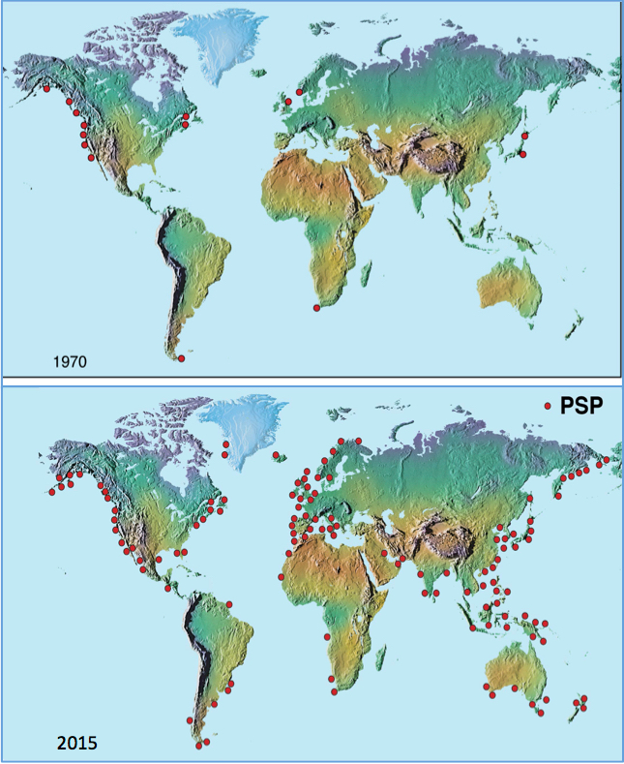
Marea roja: en.wikipedia.org/wiki/Red_tide

Slide 3
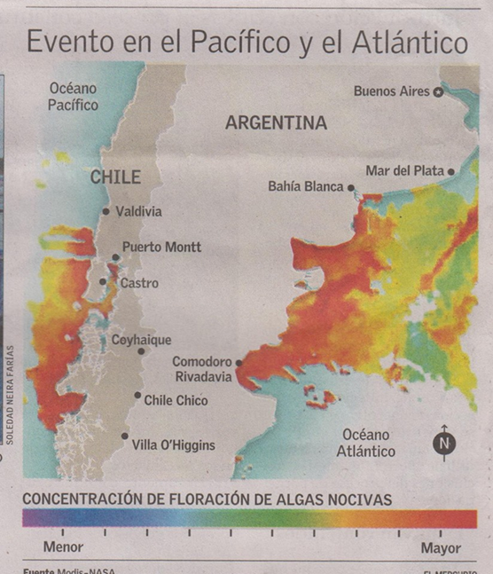
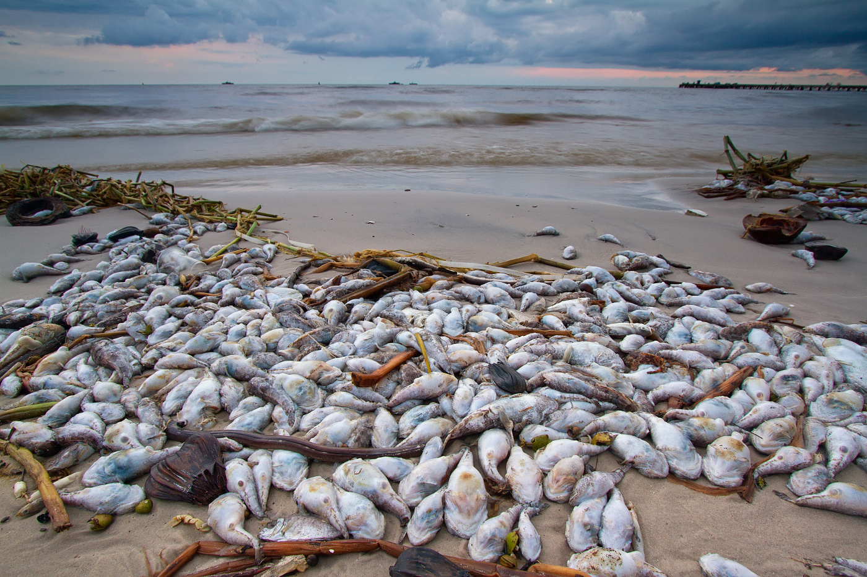
Marea roja (FAN): en.wikipedia.org/wiki/Red_tide

Slide 4
Principales toxinas y sus efectos en el sur humano
Veneno Paralizante de los Mariscos (VPM), la toxina (compuesta por diferentes toxinas, que tienen diferentes grados o poderes de toxicidad) se une a receptores neuronales (canales de sodio), impidiendo o bloqueando el impulso nervioso. Esto provoca en el ser humano una parálisis progresiva en todo el cuerpo que termina con un paro cardio-respiratorio, provocando la muerte de la persona si ella no está cerca de un centro asistencial. Esta toxina es la más nociva de las que existen y el grado de toxicidad en los moluscos varía entre uno y otro. Se pueden encontrar mariscos que por unidad están muy contaminados (lo que podría provocar la muerte de una persona en pocos minutos) y otros con bajas concentraciones de la toxina. Toxina producida por un dinoflagelado denominado Alexandrium Catenella.
Veneno Diarreico de los Mariscos (VDM), está también conformada por varios tipos de toxinas, de las cuales el Acido Okadaico (ácido graso), es el mas potente. Esta toxina provoca una inhibición de proteínas fosfatasas que están en las célula del epitelio intestinal, lo que genera finalmente salida de agua hacia el exterior. Esto origina finalmente una diarrea. Esta toxina es producida por otro dinoflagelado llamado Dinophysis acuta.
Veneno Amnésico de los Mariscos (VAM), el Acido Domoico (aminoácido). Es un compuesto excitatorio de los llamados neuroexitantes o excitotoxinas que interfieren con mecanismos de neurotransmisión, provocando daño a la celula neuronal y muerte celular. En el hombre este daño está asociado con la pérdida de la memoria de corto plazo y en algunos casos con la muerte de la persona. Esta toxina es producida por la Diatomea Pseudonitzchia sp. En nuestro país se ha hallado esta microalga en los canales de la XII región, pero jamas se ha detectado un FAN o Marea Roja que produzca este tipo de veneno.
Veneno de la ciguatera de los peces (VCP), produce sintomas gastrointestinales, neurogicos, y cardiovasculares. Generalmente, diarrea, vomitos, y dolores en el abdomen seguidos de disfunciones neurológicas acompañadas de cambios de temperatura, dolores musculares, mareos, ansiedad. Dependiendo del caso puede producir la muerte, y la recuperación puede tardar entre días y meses.
Veneno Neurotóxico del Marisco (VNM) produce sindrome de intoxicación aproximadamente identico al que produce la cicatera. En este caso,se producen aerosoles por acción del oleaje y pueden producir asma como síntomas. No sen han encontrado casos donde se haya producido la muerte, y al contrario de la cigatera la recuperación se consigue en días.

Slide 5


Fenómeno mundial
1793 | Columbia Británica, Canadá | Primer caso registrado
1840 | Florida, USA | Sin muertes pero sí irritación de piel al nadar y respiratoria por vaporización de toxinas
1972 |  | Dinoflagelado Alexandrium (Gonyaulax) tamarense, mareas serias porque el organismo produce saxitoxin and gonyautoxins.
1976 | Sabah, Borneo Malayo | 202 víctimas informadas, 7 muertes
www.researchgate.net/publication/26493862_Fos-sds_page_un_nuevo_metodo_para_detectar_veneno_diarreico_en_mariscos_aun_en_presencia_de_otras_ficotoxinas
www.imarpe.gob.pe/chiclayo/Mareas%20Rojas/Mareas%20Rojas.htm
Fuente: Bioplanet, 2000 / 2001
Mario Chiong PhD y Max Rutman Ms Sc.

Slide 6
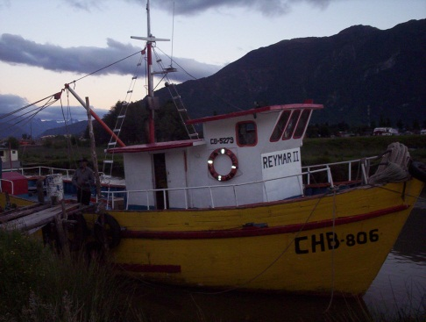
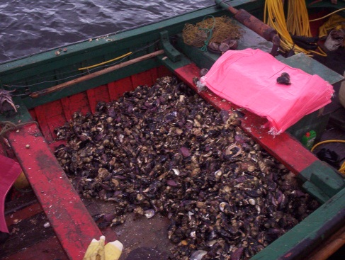
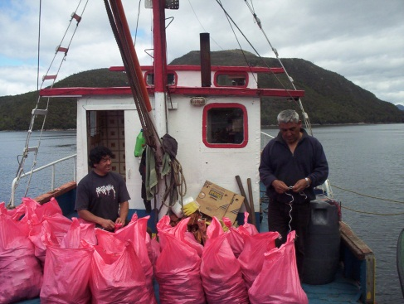
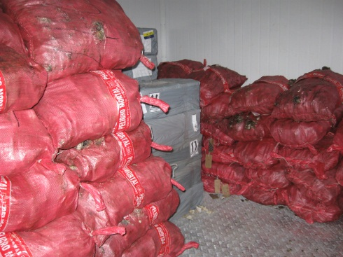
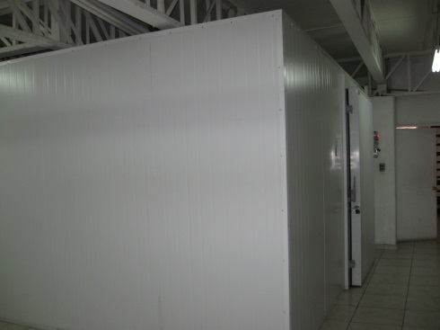
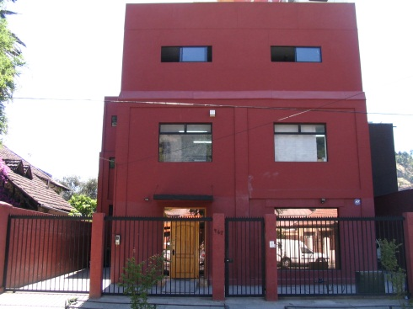
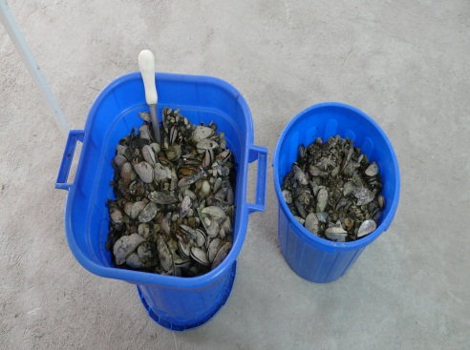
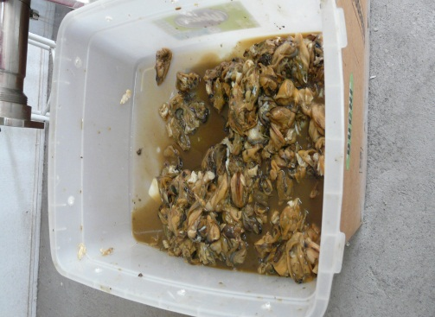
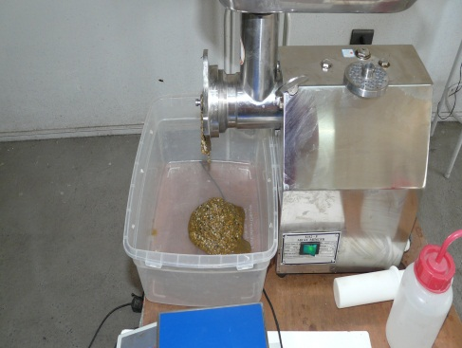
Production process
Raw material harvesting in the south of Chile
Transfer to Santiago and storage in a cold chamber
Shell removal and grinding of the meat

Slide 7
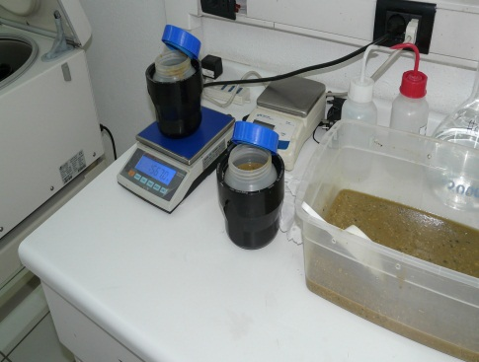
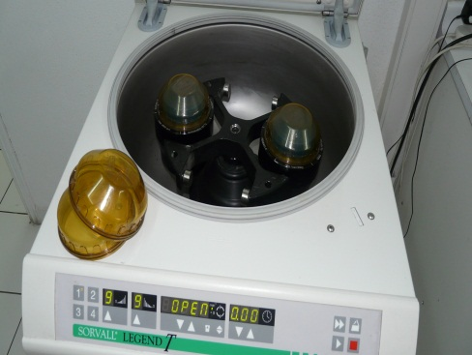
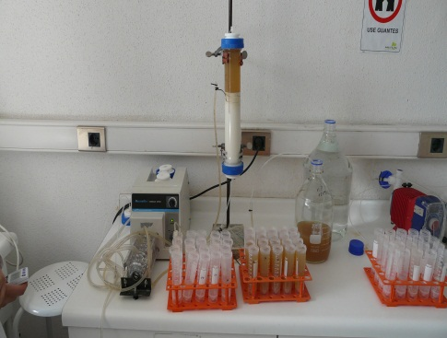
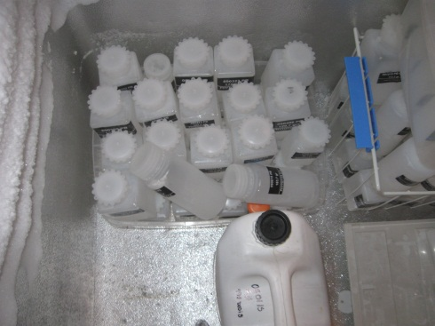
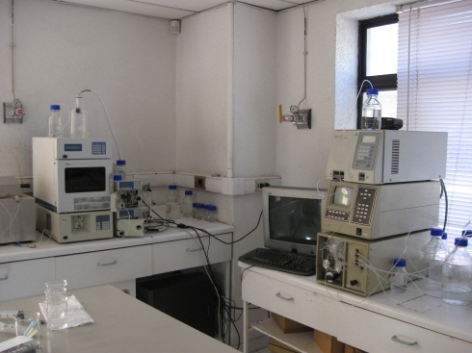
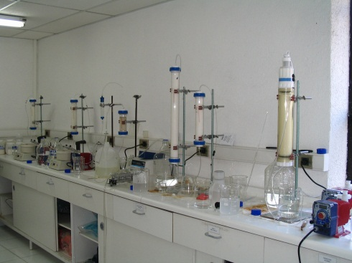
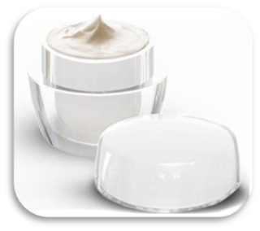

Production process
Acid extraction and chromatographic purification
HPLC ⇒ Active ingredient
Topical product
Injectable product

Slide 8
www.uspto.gov – Patent number: 6,171,626 Lagos, et al. Jan 9, 2001
Procedure for detoxification of shellfish, contaminated with paralytic shellfish toxins
Abstract:
This invention relates to a process for detoxifying shellfish contaminated with paralytic toxin. Actually no industrial method has been described that is 100% effective for detoxification of shellfish containing this type of toxins. Decontamination is achieved through a process involving the chemical treatment of shellfish. This chemical treatment consists of preincubating and then cooking the shellfish in an alkaline pH solution. This treatment can be combined with one or more other procedures for the reduction of the products' final toxicity, these other procedures including, for example, partial shellfish detoxification by depuration, removal of the most toxic parts, and commercial cooking/canning of the shellfish. The process reduces total toxicity levels in shellfish to values below 80 .mu.g of eq. STX/100 g shellfish, independently of the toxin profile, or the initial toxicity present in the shellfish. This is the first known industrial process that guarantee the shellfish decontamination 100% compatible with the international regulatory norms for human consumption.
Inventors:
Lagos; Nestor (Santiago, CL), Rutman; Max (Santiago, CL), Blamey; Jenny (Santiago, CL), Ocaranza; Maria Paz (Santiago, CL), Chiong; Mario (Santiago, CL), Hinrichsen; Juan Pablo (Santiago, CL), Lopez; Claudia (Santiago, CL)

Slide 9
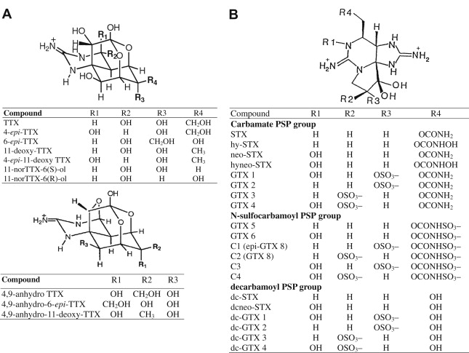
Structures of (A) TTX and (B) PSP components. GTX = gonyautoxin;
PSP = paralytic shellfish poison; STX = saxitoxin; TTX = tetrodotoxin.

Slide 10
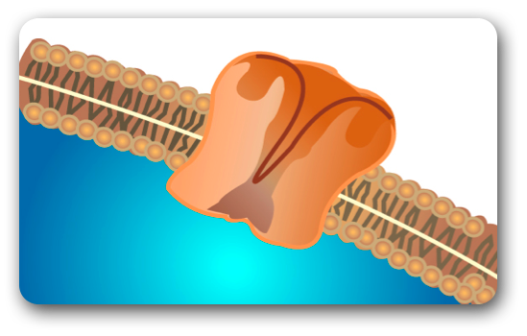
Drug development
Screening
Normal stimulation
With GTX the neurotoxin blocks the flow of ions through the channel and no nervous impulse is generated
Sodium ions flow through the channel and generate a nervous impulse transmitted by the neuron
Na+
Na+
Sodium Channel
GTX
AXON
AXON
Nervous Impulse stimulated muscle (contraction)
No nervous impulse Muscle NOT stimulated
Reversible effect and does not harm living tissue
Few and minor side effects
Short delay of action
Small molecule which enables its topical use.
Stable product
Notes:
PSP molecules. Our main focus GTX.
Large number of potential applications.
Reversible effect and does not harm living tissue.
Few and minor side effects.
Short delay of action.
Small molecule which enables its topical use.
Stable product and can be store at room temperature.

Slide 11
Drug development
Clinical proof of concept
Healthy volunteers
Non-GCP GTX in healthy adults (1) – Chile.
Anal fissure
Non-GCP GTX in patients with anal fissure n=50 (2) – Chile.
Tensional headache
Non-GCP GTX in patients with Tension-Type headache n=27 (4) – Chile.
Non-GCP GTX in patients with anal fissure (short protocol) n=23 (3) – Chile.
Garrido et al., The Gonyautoxin 2/3 Epimers Reduces Anal Tone when Injected in the Anal Sphincter of Healthy Adults, 37: 395-403 (2004).
Garrido et al.,Gonyautoxin_ New Treatment for Healing Acute and Chronic Anal Fissures, Disease of the Colon and Rectum, 48 (2):335-343 (2005).
Garrido et al. Treatment of chronic anal fissure by gonyautoxin. Cololecteral Disease. 2007. 9:619-624.
Lattes et al. Local infiltration of gonyautoxin is safe and effective in treatment of chronic tension-type headache. Neurol Res. 2009 Apr;31(3):228-33.

Slide 12
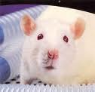
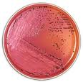
Drug development
Planned studies
14-day Toxicology in Rats
14-day Toxicology in Dogs
CNS Safety
In Vivo Cardiovascular Safety
In Vitro Cardiovascular safety
Respiratory Safety
Chromosome Aberration Test
Mouse Micronucleus Test
Preclinical
studies
Preliminary Toxicology of GTX 2/3 – Ricerca - USA
Rats
Dogs
Acute toxicity study of GTX 2/3 by single administration to CD rats – LPT - Germany
Intravenous
Acute irritation/corrosion test GTX 2/3 in rabbits – LPT - Germany
Dermal
Eye
Oral
MTD: 15µg/kg = MTD humans: 2,43 µg/kg = (60 kg): 145,8 µg
MTD: 10µg/kg = MTD humans: 5,41 µg/kg = (60 kg): 324,6 µg
NOAEL IV: 6,81µg/kg = NOAEL humans: 1,10 µg/kg =
(60 kg): 66 µg
NOAEL oral: 1000 µg/kg = NOAEL humans: 162 µg/kg =
(60 kg): 9720 µg
GTX 2/3 was non - irritating to skin, hence, no labelling is required
GTX 2/3 was non - irritating to eyes, hence, no labelling is required
AMES (Salmonella typhimurium reverse mutation assay) of GTX 2/3
No mutagenic effect was observed for GTX 2/3

Slide 13
Drug development
Screening
Preclinical
studies
IND
FDA
Phase 1
Phase 2
Phase 3
NDA
FDA
Sales
Screening
Clinical proof of concept
Preclinical
studies
Notes:
Plantear preguntas que se deben contestar:
Seguridad, eficacia, etc…

Slide 14
Patents
Brazil, Canada, China, Europe, Hong Kong, India, Japan, Mexico, Indonesia, Poland, South Korea, USA
Australia, Brazil, Canada, Europe, USA, China, Japan, India, Mexico, Hong Kong
Australia, Brazil, Canada, Europe, USA, China, Japan, India, Mexico, Hong Kong
Methods of treating wounds with gonyautoxins
Transdermal administration of phycotoxins
2004
2004
Pharmaceutical compositions containing 3,4-propenoperhydropurines
Europe, Australia, Japan
Phycotoxins and uses thereof
2001
Use of phycotoxins in veterinary applications
Eurasia, Singapore, South Africa, New Zeland, Australia, Chile
2004
Australia, Brazil, Canada, Europe, USA, China, Japan, India, Mexico, Hong Kong
2005
Sodium Channel Blocker
2010
Europe, USA for priority date
Notes:
Patent
Description
Pharmaceutical compositions containing 3, 4-propenoperhydropurines
Compositions and methods comprising an effective amount of at least one tricyclic 3,4-propinoperhydropurine for interfering in neuronal transmission and muscle contraction, treatment of anal fissure, manufacture of medicament and cosmetic formulation, reducing wrinkles and facial rejuvenation.
Methods of treating wounds with gonyautoxins
Methods of treating wounds and anal fissure with compositions of the invention including one or more tricyclic 3,4-propinoperhydropurines and in combinations with an effective amount of another neurotoxin and/or a local anesthetic.
Transdermal administration of phycotoxins
Pharmaceutical compositions and a transdermal delivery system for transdermal administration of at least one phycotoxin, for interfering with neuronal transmission and for facial rejuvenation. The transdermal drug delivery system may be selected from chemical systems and physical means.
Use of phycotoxins in veterinary applications
Methods of treating animals in need with compositions of the invention including one or more tricyclic 3,4-propinoperhydropurines and in combination with an effective amount of a neurotoxin and/or a local anesthetic.
Phycotoxins and uses thereof
Methods of treating various ailments comprising the step of administering an effective amount of the pharmaceutical compositions containing one or more gonyautoxins. In the methods, muscle relaxation and/or anesthetization is employed for the purpose of providing a beneficial treatment. In addition, pharmaceutical compositions for interfering with neuronal transmission comprising an effective amount of at least one tricyclic 3,4-propinoperhydropurine and at least one other active ingredient, and preparations for facial rejuvenation.
Sodium Channel Blocker
A sodium channel blocker (saxitoxin or derivatives; tetrodotoxin or derivative; or one tricyclic 3,4-propinoperhydropurine) for the treatment of a reduction or loss of superficial sensitivity or sense of touch of a human being or another mammal.

Slide 15

INVESTIGACIÓN
FACULTAD DE INGENIERÍA Y TECNOLOGÍA

Slide 16

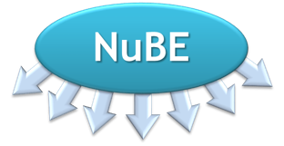
Organizaciones
Empresas
CAPITAL HUMANO AVANZADO
Docentes
Investigadores
Ingenieros
Estudiantes
PROBLEMATICAS REALES
Proyectos
Investigaciones
Actividades Conjuntas
Investigación Aplicada
Congresos
Publicaciones
Patentes
Intercambio capital humano avanzado
Convenios
Nacionales
Internacionales

